Slide 1
Engine Controller
Team 513

Slide 2
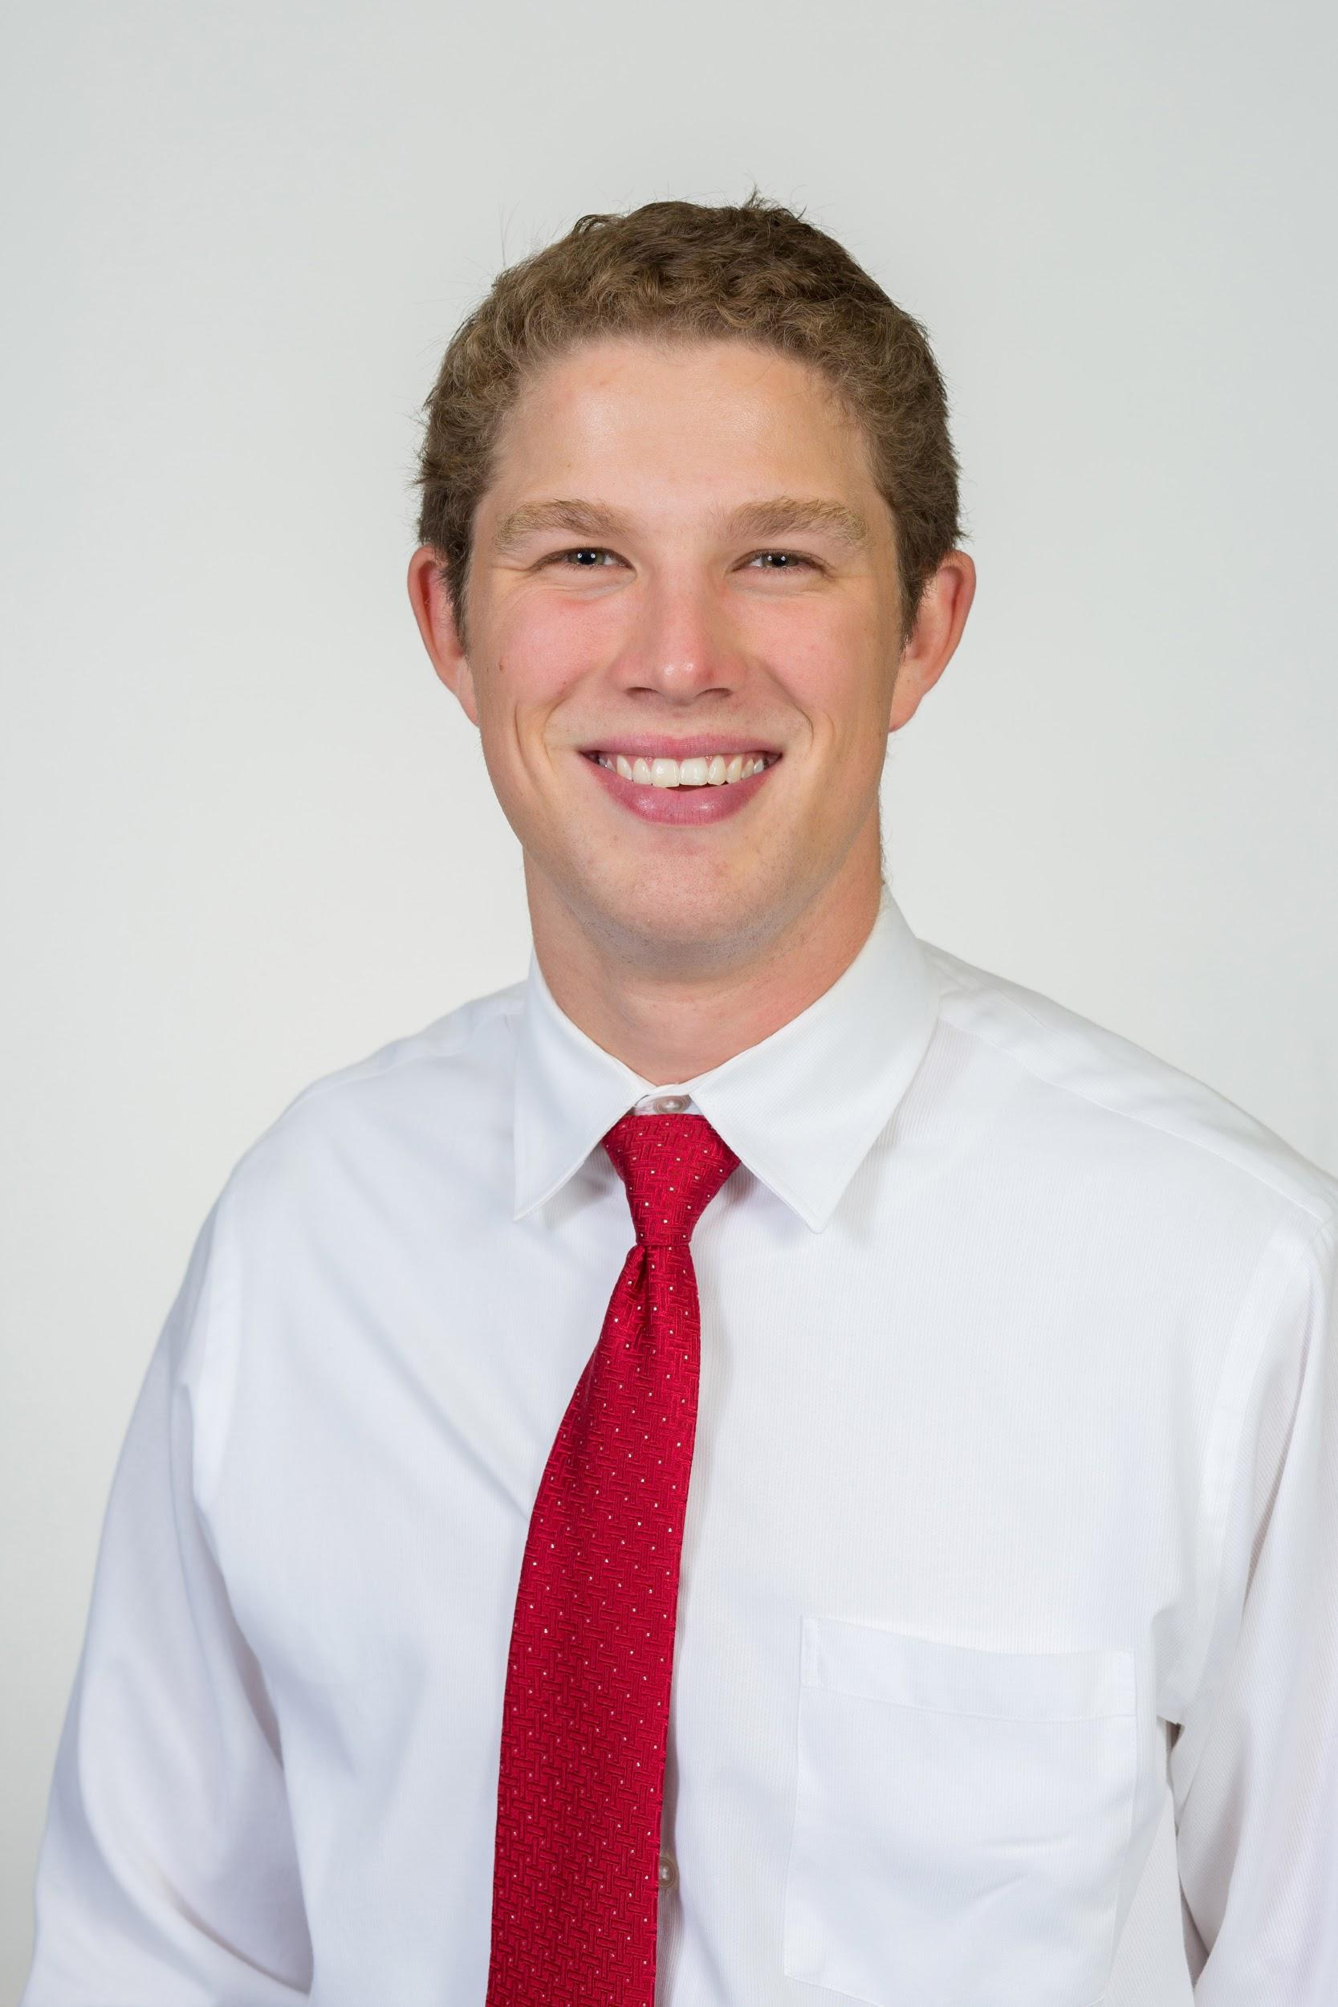
Team 513
Patrick Marlatt
Project
Engineer
Fred Peterson
Mechanical
Design Engineer
Austin LaFever
Software and Controls Engineer
Jonathan Wozny
Thermal Fluids Control Engineer
Patrick Marlatt

Slide 3
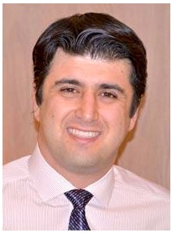
Sponsors and Advisor
Engineering Mentor
Roberto Valenti
Project Advisor
Engineering Mentor
Peter Maloney
Controls Advisor
Academic Advisor
Dr. Shoele, Ph.D.
Assistant Professor
Patrick Marlatt

Slide 4
Objective
Create and implement a Multi-Input Multi-Output control system that works with the current system to improve the throttle and wastegate control in the MathWorks Powertrain Blockset.
Frederick Peterson

Slide 5
Motivation
- Internal combustion engines will be prevalent for the foreseeable future.
- Continue to improve performance, fuel economy, and emissions to stay viable.
- General Motors has an engine line implementing torque-tracking model predictive control (MPC).
- MathWorks wants a torque-tracking MPC to be added to their engine dynamometer simulation to be able to design a broad range of engines.
Frederick Peterson

Slide 6
Key Markets
Engine Manufacturers
Emissions Test Agencies
Engine Simulation Technology
(GT Power)
Research
Frederick Peterson

Slide 7
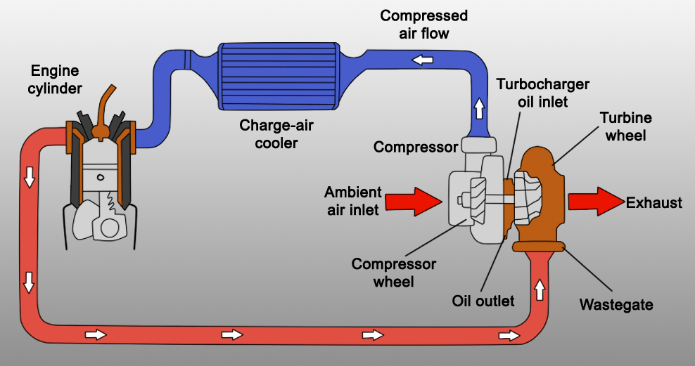
Key Concepts
Throttle
Frederick Peterson

Slide 8
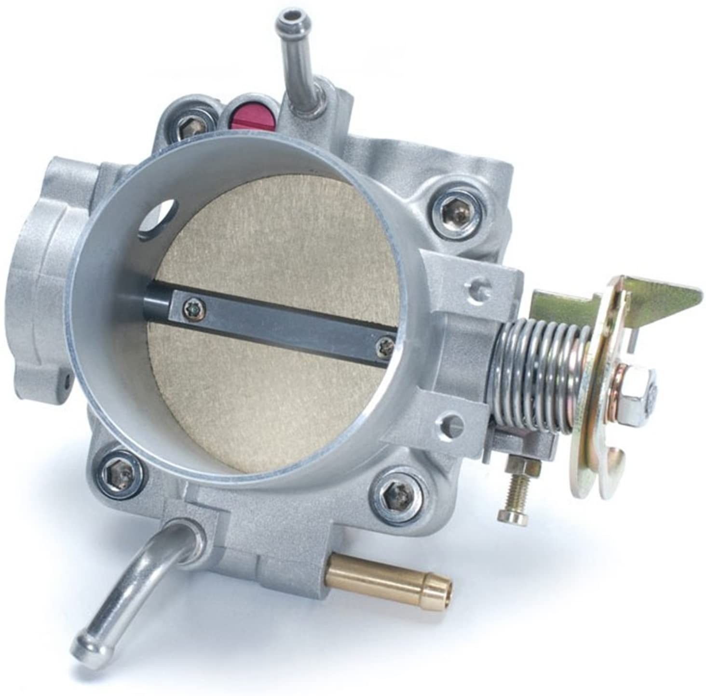
Key Concepts
Throttle
Wastegate
Frederick Peterson

Slide 9
Key Concepts
A control method that passes a controlling signal from one point in the system to another to control the output.
Feed Forward Control
Frederick Peterson

Slide 10
Key Concepts
A system with multiple inputs and sends multiple outputs.
Multi-Input Multi-Output
(MIMO)
Frederick Peterson

Slide 11
Key Concepts
A control method that uses a model of the system to make predictions about the future outputs.
Model Predictive Control
(MPC)
Frederick Peterson

Slide 12
Engine Dynamometer
Patrick Marlatt

Slide 13
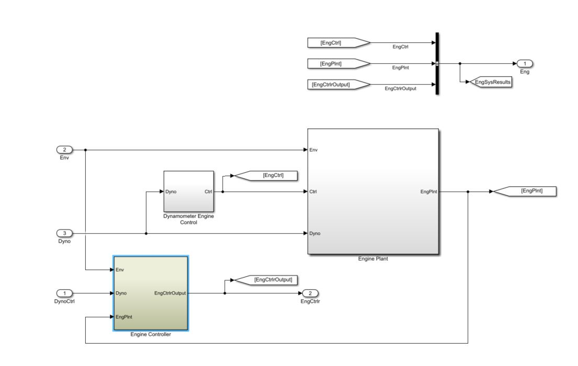
Engine Control System
Patrick Marlatt

Slide 14
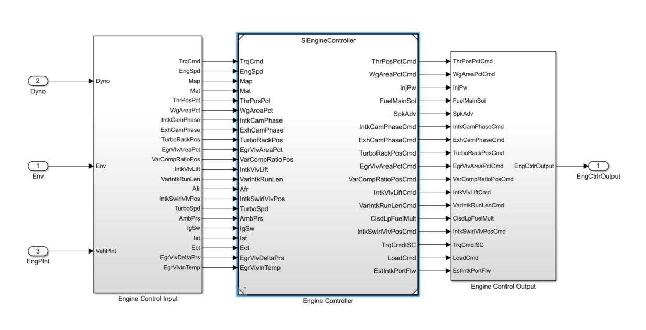
Engine Controller
Patrick Marlatt

Slide 15
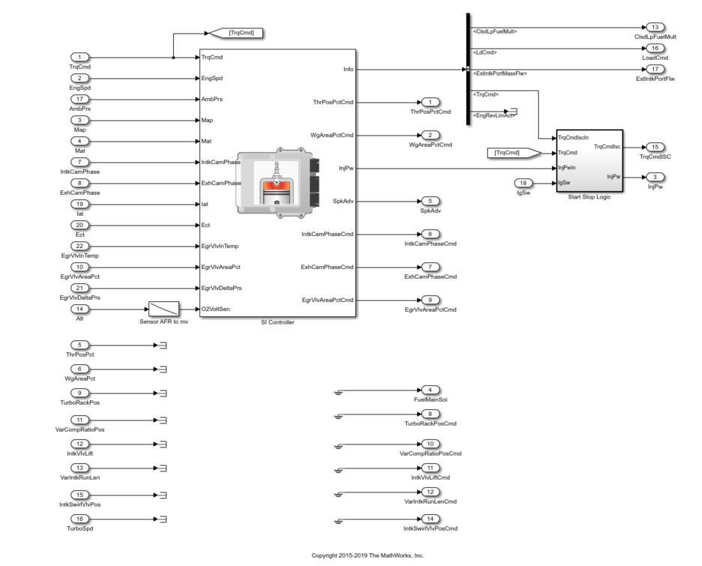
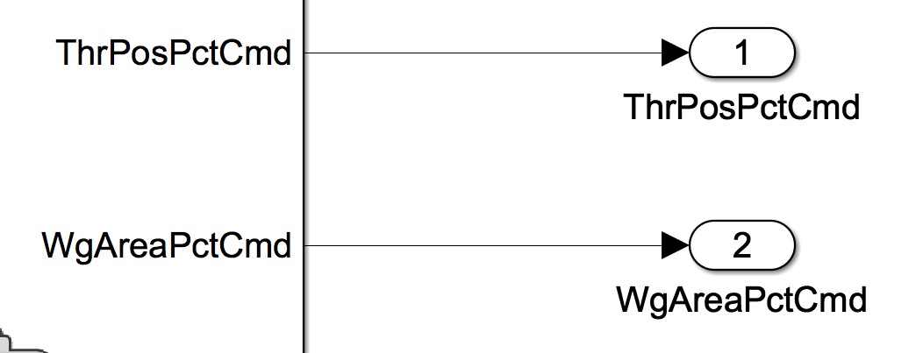
Patrick Marlatt

Slide 16
T513
Controller
Patrick Marlatt

Slide 17
Dynamometer Torque Response
Patrick Marlatt

Slide 18
Customer Needs
Comprehensive
Improved Torque Output
Wastegate Control
Throttle Control
MIMO
Patrick Marlatt

Slide 19
Customer Needs
Comprehensive
Improved Torque Output
Wastegate Control
Throttle Control
MIMO
Patrick Marlatt

Slide 20
Customer Needs
Comprehensive
Improved Torque Output
Wastegate Control
Throttle Control
MIMO
Patrick Marlatt

Slide 21
Customer Needs
Comprehensive
Improved Torque Output
Wastegate Control
Throttle Control
MIMO
Patrick Marlatt

Slide 22
Customer Needs
Comprehensive
Improved Torque Output
Wastegate Control
Throttle Control
MIMO
Patrick Marlatt

Slide 23
Functional Decomposition
MIMO Control System
Air Flow Control
Receives Multiple Inputs
Receives Throttle Position Command
Receives Wastegate Position Command
Returns Multiple Outputs
Returns Throttle Position
Returns Wastegate Position
Handles Differing Parameters
Operates for Varying Displacements
Operates for Varying Desired Powers
Operates for Varying Number of Cylinders
Integration
Works in conjunction with current feed forward controls
Estimation Improvement
Align Output Torque with Desired
Drive Lambda ~ 1
Improve Time Response
Measure Error
Frederick Peterson

Slide 24
Functional Decomposition
MIMO Control System
Air Flow Control
Receives Multiple Inputs
Receives Throttle Position Command
Receives Wastegate Position Command
Returns Multiple Outputs
Returns Throttle Position
Returns Wastegate Position
Handles Differing Parameters
Operates for Varying Displacements
Operates for Varying Desired Powers
Operates for Varying Number of Cylinders
Integration
Works in conjunction with current feed forward controls
Estimation Improvement
Align Output Torque with Desired
Drive Lambda ~ 1
Improve Time Response
Measure Error
Frederick Peterson

Slide 25
Functional Decomposition
MIMO Control System
Air Flow Control
Receives Multiple Inputs
Receives Throttle Position Command
Receives Wastegate Position Command
Returns Multiple Outputs
Returns Throttle Position
Returns Wastegate Position
Handles Differing Parameters
Operates for Varying Displacements
Operates for Varying Desired Powers
Operates for Varying Number of Cylinders
Integration
Works in conjunction with current feed forward controls
Estimation Improvement
Align Output Torque with Desired
Drive Lambda ~ 1
Improve Time Response
Measure Error
Frederick Peterson

Slide 26
Functional Decomposition
MIMO Control System
Air Flow Control
Receives Multiple Inputs
Receives Throttle Position Command
Receives Wastegate Position Command
Returns Multiple Outputs
Returns Throttle Position
Returns Wastegate Position
Handles Differing Parameters
Operates for Varying Displacements
Operates for Varying Desired Powers
Operates for Varying Number of Cylinders
Integration
Works in conjunction with current feed forward controls
Estimation Improvement
Align Output Torque with Desired
Drive Lambda ~ 1
Improve Time Response
Measure Error
Frederick Peterson

Slide 27
Functional Decomposition
MIMO Control System
Air Flow Control
Receives Multiple Inputs
Receives Throttle Position Command
Receives Wastegate Position Command
Returns Multiple Outputs
Returns Throttle Position
Returns Wastegate Position
Handles Differing Parameters
Operates for Varying Displacements
Operates for Varying Desired Powers
Operates for Varying Number of Cylinders
Integration
Works in conjunction with current feed forward controls
Estimation Improvement
Align Output Torque with Desired
Drive Lambda ~ 1
Improve Time Response
Measure Error
Frederick Peterson

Slide 28
Future Work
 | OCTOBER |  |  |  |  | NOVEMBER
 | 27 | 28 | 29 | 30 | 31 | 1 | 2 | 3 | 4 | 5 | 6 | 7 | 8 | 9 | 10 | 11 | 12 | 13
Target and Metrics
Concept Generation
Concept Selection
MPC Prototyping (Controls Team)
Thermo Equations (Physical Team)
Crude MPC
VDR2
Austin's Birthday
Patrick Marlatt

Slide 29
Recap
- Improving MATLAB engine controller
- Improve model fuel efficiency
- Improve accuracy of torque command vs output
- Recommended use of model predictive control
Patrick Marlatt

Slide 30
References
L, R. (2016, February 27). How to Get the Most Horsepower Out of Your Car. Retrieved October 16, 2020, from
https://www.yourmechanic.com/article/how-to-maximize-the-horsepower-of-your-car
Bemporad, A., Bernardini, D., Long, R., & Verdejo, J. (2018). Model Predictive Control of Turbocharged Gasoline Engines for Mass Production. SAE Technical Paper Series. doi:10.4271/2018-01-0875
“How Does a Wastegate Work? - Turbosmart - Engineered To Win!” Turbosmart, Turbosmart, 10 May 2020,
www.turbosmart.com/new/how-does-a-wastegate-work/
"Skunk2 309-05-1030 Alpha Series Throttle Body,Silver." Amazon.com, Inc. Amazon. 2020. https://www.amazon.com/
Skunk2-309-05-1030-Alpha-Throttle-Body/dp/B008M5ISEU

Slide 31
Questions...

Slide 32
Backup Slides

Slide 33
Functional Decomposition: Cross Reference Table
Function | Air Flow Control | Integration | Estimation Improvement
Receives Multiple Inputs | x
Receives Throttle Position Command | x
Receives Wastegate Position Command | x
Returns Multiple Outputs | x
Returns Throttle Position | x
Returns Wastegate Position
Handles Differing Parameters | x | x
Operates for Varying Displacements | x | x
Operates for Varying Desired Powers | x | x
Operates for Varying Number of Cylinders | x | x
Works in conjunction with Current Feeed Forward Controls | x | x
Align Output Torque with Desired | x |  | x
Measure Error |  |  | x
Drive Lambda ~ 1 | x |  | x
Improves Time Response | x |  | x

Slide 34
Customer Needs
Question | Answer | Interpreted Need
Is it required to use model predictive control, or can we use controls that we are more familiar with, like PID, table-based, etc.? | We have been looking into MPC recently, and from our research, MPC seems to be the very best approach to solving the problem. | Use MPC control for project approach.
What will we be using as inputs and outputs to our control system? | A good start place to get familiar with simulink and the control system is the wastegate and throttle. If you start there, we can see what else you can add. | The control system implements the throttle and wastegate. Additional factors can be included.
How would we know if our control system is accurate? | Running the program produces a graph of desired intake vs actual intake. The closer the two lineup, the better your system. | The control system only demands what the system can provide. The blockset will produce a graph to ensure accuracy.
What is the main goal of this project? | The main goal is to integrate and simulate an MPC controller block in the powertrain block control set. The MPC should control the throttle and wastegate to get the ideal boost for the system. The new MPC controller designed by the group will replace the existing control system. | Create an MPC controller that will control the throttle and wastegate inputs to replace the existing outdated controller.

Slide 35
What is a good place to get started?​​ ​​ ​​ | Play around with the power train blockset. Go through it, see how it all works; change the inputs and see what happens. ​​ ​​ ​​ | ​​ ​​
What can we do while we wait for the blockset?​​ ​​ ​​ | There are apps on the market to record your car’s information [ on the throttle and wastegate], that information will help get started​​ ​​ ​​ | Our model results can be compared to physical systems​​ ​​ ​​
What is the best way to simulate our controller within the system?​​ ​​ ​​ | The powertrain blockset and Simulink can be used to simulate the system. We will look into getting the group access to GT Power as it has more specific engine models and GT Power is used the most in the industry for these types of simulations.​​ ​​ ​​ | Use powertrain blockset and Simulink for simulations and perhaps GT Power later on in the project. ​​ ​​ ​​ ​​

